Slide 1
329 Final Project
By Josh Harper & Jordan Harper

Slide 2
Scope
Apply knowledge learned in class to create and online booking system
Modeled after bookit.com
Identify Design Tasks
Timeline
Communication Plan
Risk Analysis

Slide 3
Responsibilities
Jordan Harper
5 Screen sketches
Risk analysis
Identify key concepts
Partial Communication Plan
Create and Manage GitHub
Josh Harper
5 Screen sketches
Risk analysis
Client Communication
Create timeline
Partial Communication Plan

Slide 4
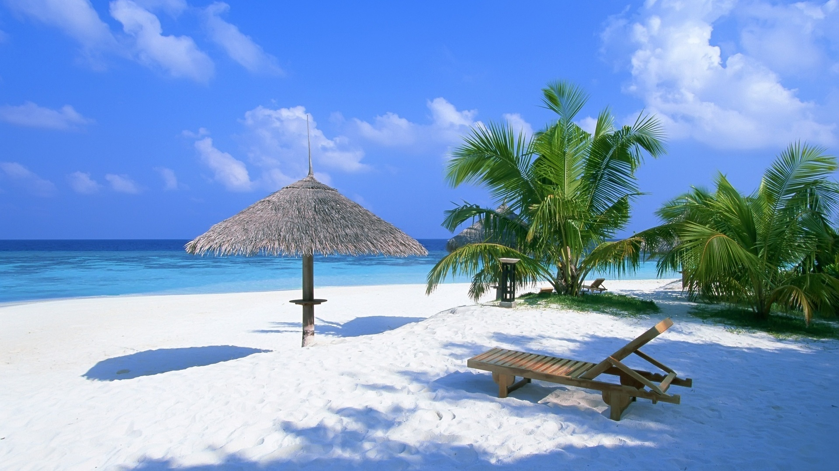
TravelLock
VACATIONS HOTELS FLIGHTS THINGS TO DO DESTINATIONS
HOTSPOTS
SEARCH DESTINATIONS
VACATION PACKAGES
TODAY’S DEALS

Slide 5
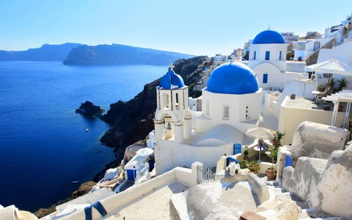
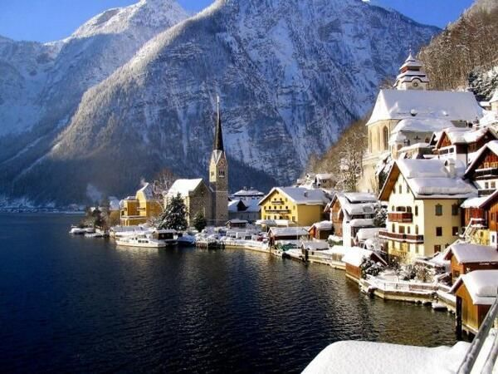
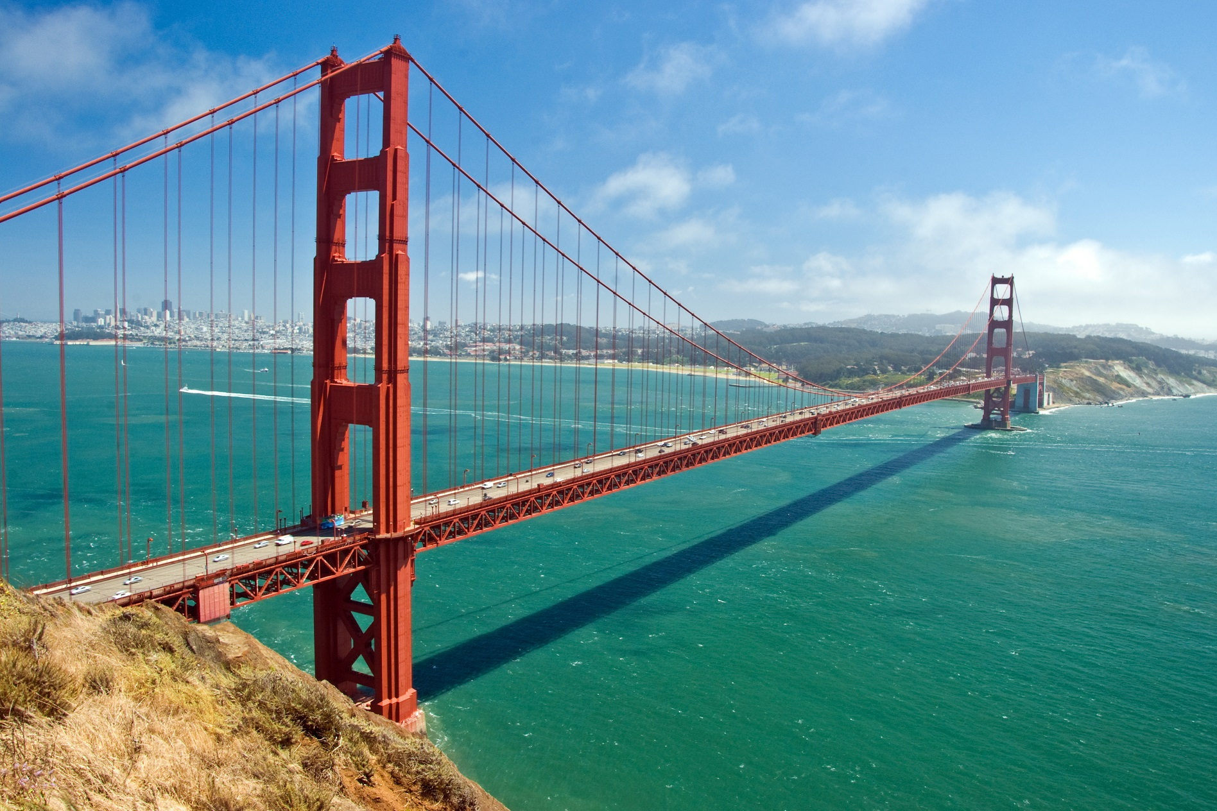
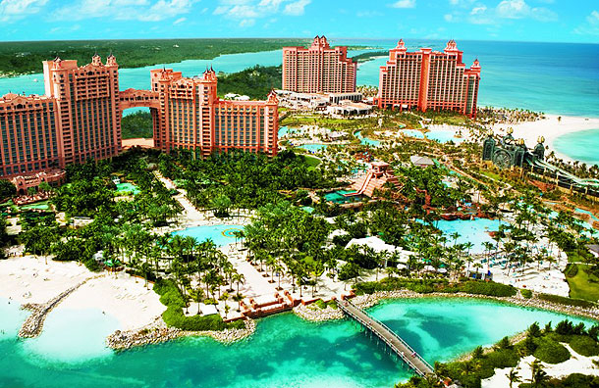
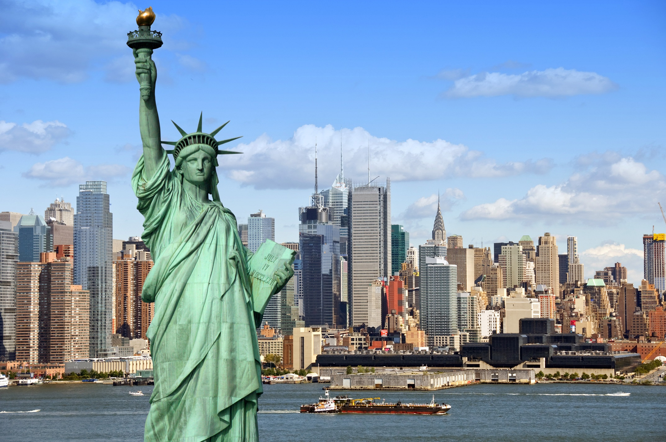
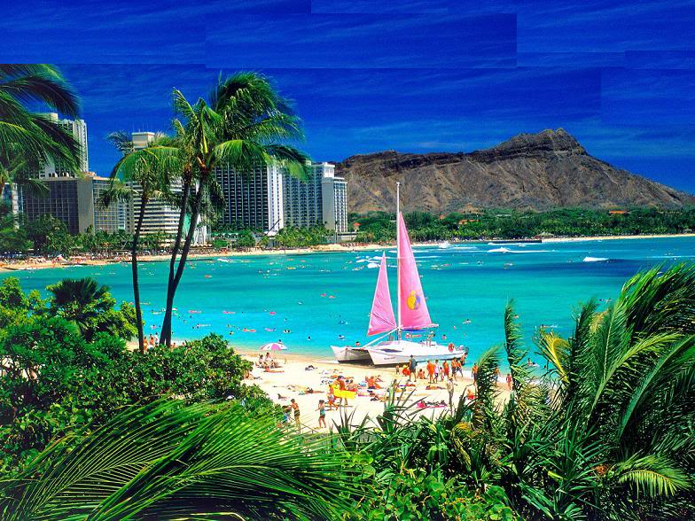
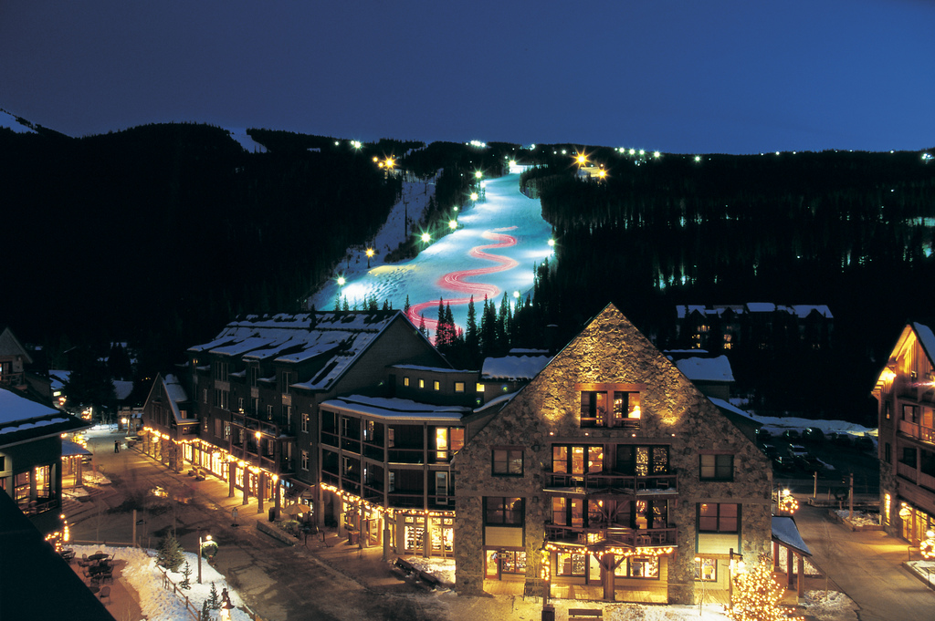
TravelLock
VACATIONS HOTELS FLIGHTS THINGS TO DO DESTINATIONS
Destination Title
Information on the destination
Rating:
From
$350
Per guest
Per night
Destination Title
Information on the destination
Rating:
From
$350
Per guest
Per night
Destination Title
Information on the destination
Rating:
From
$350
Per guest
Per night
Destination Title
Information on the destination
Rating:
From
$350
Per guest
Per night
Destination Title
Information on the destination
Rating:
From
$350
Per guest
Per night
Destination Title
Information on the destination
Rating:
From
$350
Per guest
Per night
Destination Title
Information on the destination
Rating:
From
$350
Per guest
Per night
Destination Title
Information on the destination
Rating:
From
$350
Per guest
Per night
Destination Title
Information on the destination
Rating:
From
$350
Per guest
Per night
Destination Title
Information on the destination
Rating:
From
$350
Per guest
Per night

Slide 6
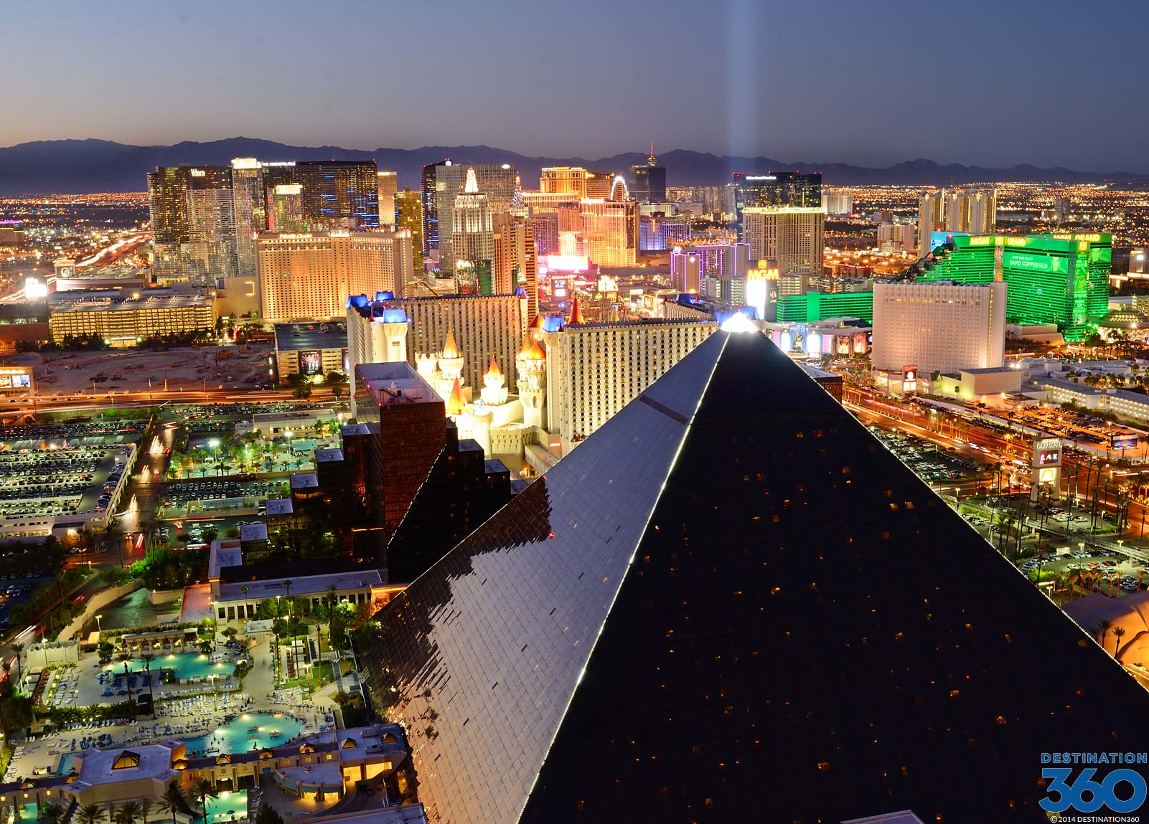
TravelLock
VACATIONS HOTELS FLIGHTS THINGS TO DO DESTINATIONS
Destination 1
Description of destination 1
Facts about destination 1
Facts about destination 1
Facts about destination 1
Facts about destination 1
Rating:
Destination 2
Description of destination 2
Facts about destination 2
Facts about destination 2
Facts about destination 2
Facts about destination 2
Rating:
Average hotel price per night:
$800
Average hotel price per night:
$800

Slide 7



TravelLock
VACATIONS HOTELS FLIGHTS THINGS TO DO DESTINATIONS
From
To
Departing
Returning
Search for flights
Des Moines, IA, US
Los Angelus, CA, US
mm/dd/yyyy
mm/dd/yyyy
SEARCH
From: City
Destination: City
Departure time: 10:00am CST
Airline: Airline name
Seats Remaining: Sold Out
PURCHASE TICKETS
From: City
Destination: City
Departure time: 6:00am CST
Airline: Airline name
Seats Remaining: 15 Seats
PURCHASE TICKETS
From: City
Destination: City
Departure time: 8:00am CST
Airline: Airline name
Seats Remaining: Sold Out
PURCHASE TICKETS
From: City
Destination: City
Departure time: 10:00am CST
Airline: Airline name
Seats Remaining: Sold Out
PURCHASE TICKETS

Slide 8
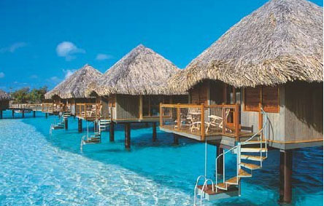
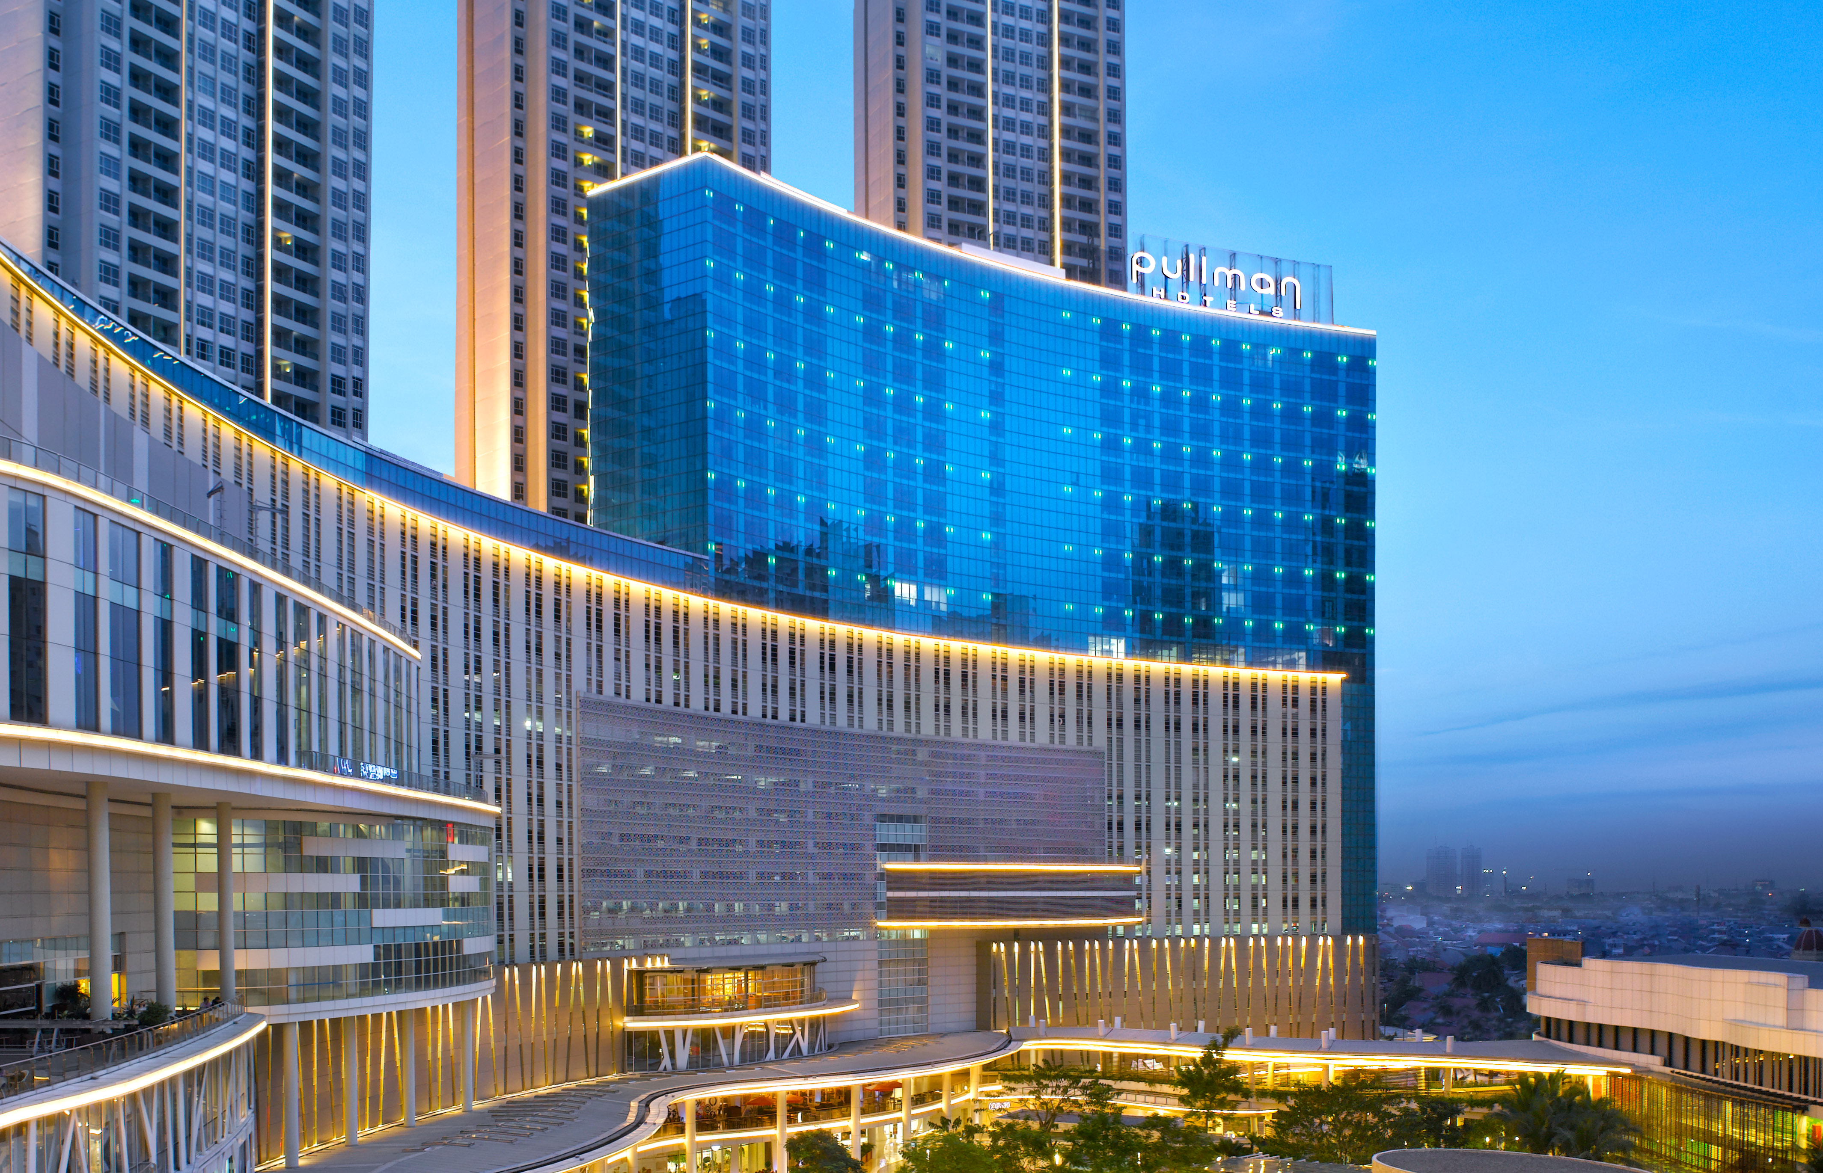
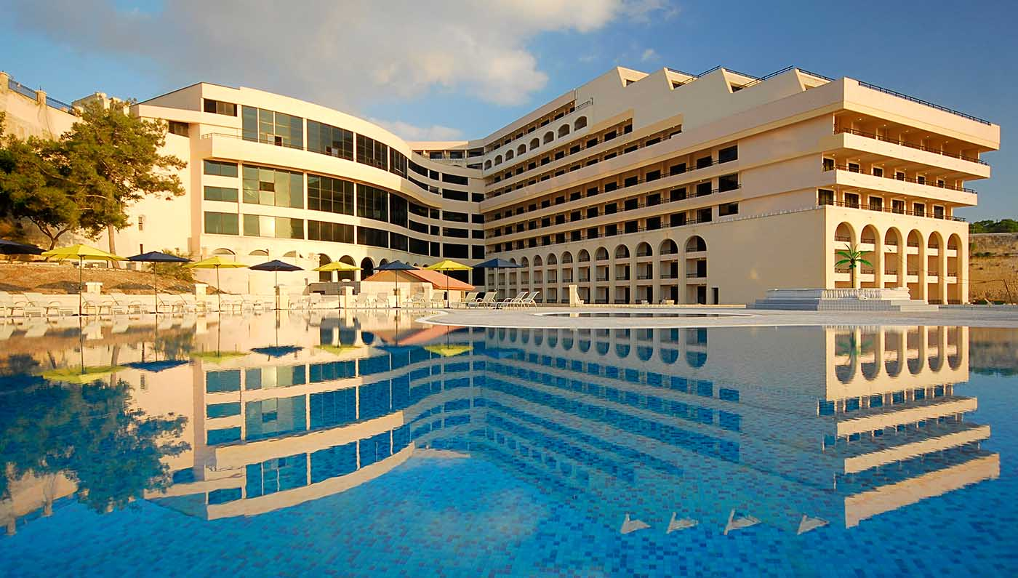
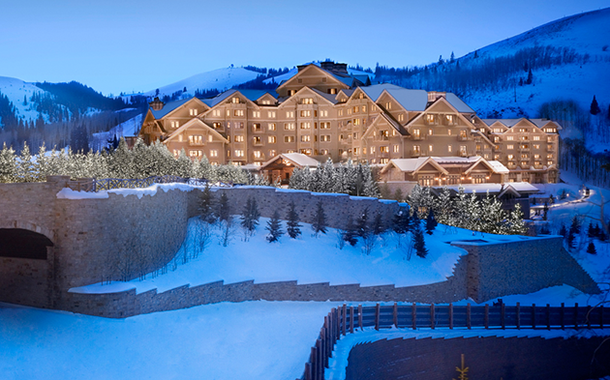
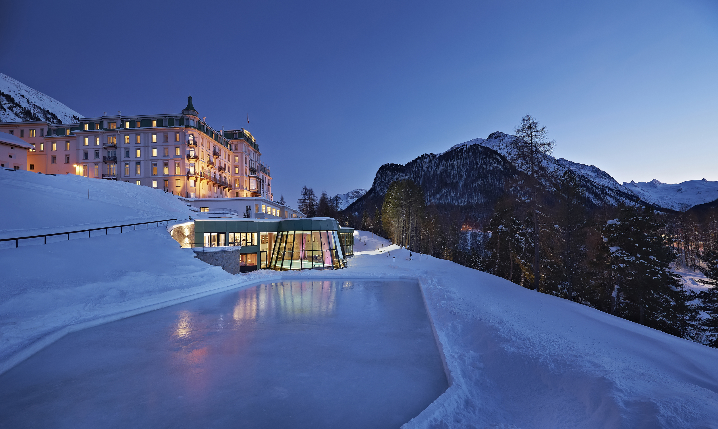
TravelLock
VACATIONS HOTELS FLIGHTS THINGS TO DO DESTINATIONS
Hotels in Queenstown New Zealand
Hotel Name
Information on the hotel
Rating:
From
$350
Per night
Hotel Name
Information on the hotel
Rating:
From
$350
Per night
Hotel Name
Information on the hotel
Rating:
From
$350
Per night
Hotel Name
Information on the hotel
Rating:
From
$350
Per night
Hotel Name
Information on the hotel
Rating:
From
$350
Per night
Hotel Name
Information on the hotel
Rating:
From
$350
Per night
Hotel Name
Information on the hotel
Rating:
From
$350
Per night
Hotel Name
Information on the hotel
Rating:
From
$350
Per night
Hotel Name
Information on the hotel
Rating:
From
$350
Per night
Hotel Name
Information on the hotel
Rating:
From
$350
Per night

Slide 9
TravelLock
VACATIONS HOTELS FLIGHTS THINGS TO DO DESTINATIONS
Check In
Check Out (Optional)
Available Rooms at The Holiday Inn
mm/dd/yyyy
mm/dd/yyyy
Capacity: 4
Description:
BOOK ROOM
Capacity: 4
Description:
BOOK ROOM
Capacity: 4
Description:
BOOK ROOM
Capacity: 4
Description:
BOOK ROOM

Slide 10
TravelLock
VACATIONS HOTELS FLIGHTS THINGS TO DO DESTINATIONS
Vacation Package Name
Description of vacation package
Number of people
Facts about destination
Facts about destination
Rating:
Vacation Package Name
Description of vacation package
Number of people
Facts about destination
Facts about destination
Rating:
Total Price:
$800
Total Price:
$800
Vacation Package Name
Description of vacation package
Number of people
Facts about destination
Facts about destination
Rating:
Vacation Package Name
Description of vacation package
Number of people
Facts about destination
Facts about destination
Rating:
Total Price:
$800
Total Price:
$800

Slide 11
TravelLock
VACATIONS HOTELS FLIGHTS THINGS TO DO DESTINATIONS MANAGE
Manage Rooms at The Holiday Inn
Capacity: 4
Description:
MAKE AVAILABLE
Capacity: 3
Description:
MAKE AVAILABLE
Capacity: 7
Description:
MAKE AVAILABLE
Capacity: 4
Description:
MAKE AVAILABLE

Slide 12
TravelLock
VACATIONS HOTELS FLIGHTS THINGS TO DO DESTINATIONS
Please enter your payment information
Check In
Check Out (Optional)
Available Rooms at The Holiday Inn
mm/dd/yyyy
mm/dd/yyyy
Name on Card
Card Number
Capacity: 4
Description:
Street Address
Expiration Date
BOOK ROOM
City
Security Code
State
Card Type
Capacity: 4
Description:
Email
BOOK ROOM
Capacity: 4
Description:
BOOK ROOM
COMPLETE PURCHASE
Capacity: 4
Description:
BOOK ROOM

Slide 13
TravelLock
VACATIONS HOTELS FLIGHTS THINGS TO DO DESTINATIONS
You have successfully booked your room
A receipt has been sent to your email
Hotel:
Room:
Description
Name:
Email:
Address:
City:
State:
Card Type:
Card Number:

Slide 14
https://github.com/jharper0114/JoshHarper-JordanHarper-Bookit

